Slide 1
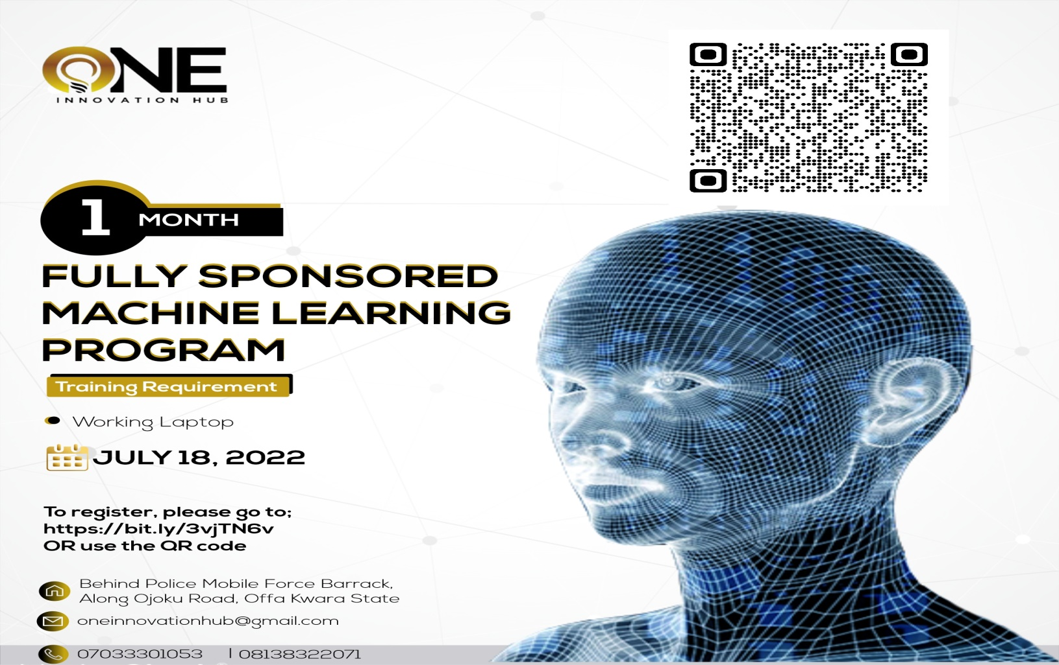
WELCOME TO ONE INNOVATION HUB
30 DAYS OF MACHINE LEARNING

Slide 2
WHAT TO EXPECT
Understanding of Python Programming
Introduction to the foundations of Machine Learning
Using Version Control with git for collaborating
Entering into hackathons
Starting a career in Data Science, Machine Learning and other related fields

Slide 3
ROADMAP
Welcome to Data Science and Machine Learning at One Innovation Hub
Week 1-2: Python for Data Science and Machine Learning
Introduction to Version Control with Git
Basic concepts of python programming
Week 2: Data Wrangling
Data Analysis and Visualization

Slide 4
Week 3-4: Machine Learning Basics
Introduction to ML tools
Supervised and Unsupervised Machine learning
Machine learning algorithm
Week 5: Model Deployment & Project
Flask
Streamlit

Slide 5
WHAT IS EXPECTED FROM PARTICIPANTS
75% attendance – less than that will lead to no certificate
Group Project that will officially kickstart by 2nd week
Collaboration on the DSNOffa Github page
Daily/Weekly posting of contents learnt

Slide 6
ANY questions??

